Slide 1
ESPEN Practical Guideline on Clinical Nutrition in Cancer Patients
Summary

Slide 2
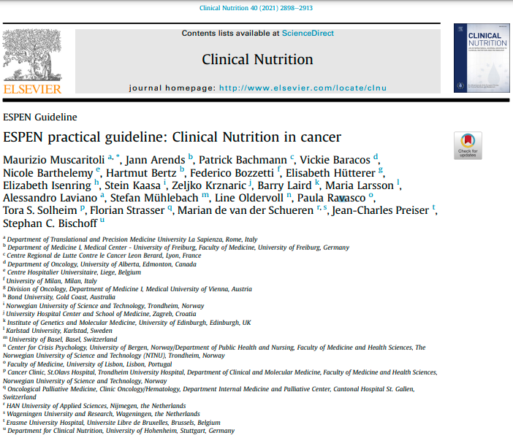

Slide 3
CLINICAL QUESTION:
General concepts of treatment relevant to all cancer patients.

Slide 4
SCREENING AND ASSESSMENT
To detect nutritional disturbances at an early stage, we recommend to regularly evaluate nutritional intake, weight change, and body mass index (BMI), beginning with cancer diagnosis and repeated depending on the stability of the clinical situation.
GRADE OF RECOMMENDATION
Strength of recommendation strong - Level of evidence very low – strong consensus
SCREENING AND ASSESSMENT
In patients with abnormal screening, we recommend objective and quantitative assessment of nutritional intake, nutrition impact symptoms, muscle mass, physical performance and the degree of systemic inflammation.
GRADE OF RECOMMENDATION
Strength of recommendation strong - Level of evidence very low – strong consensus

Slide 5
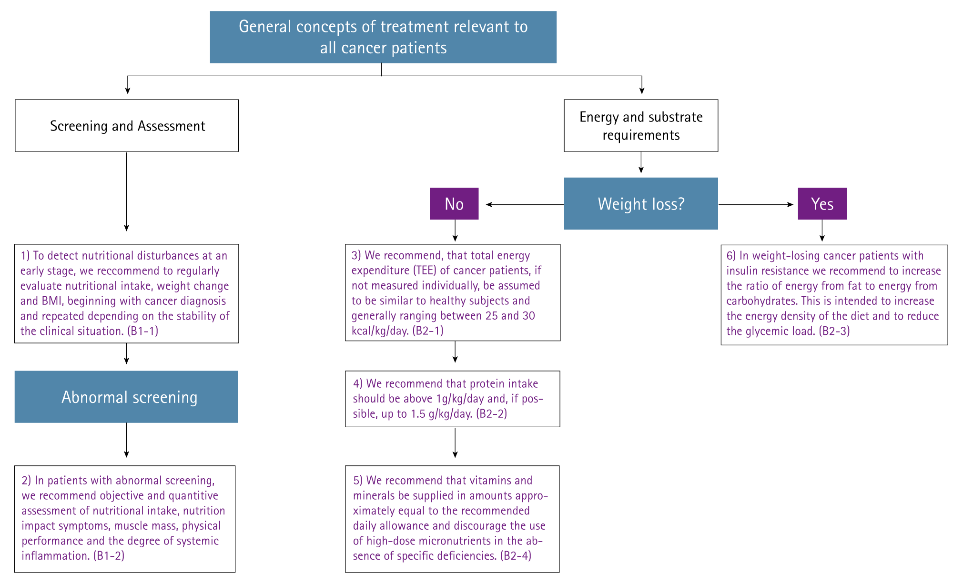
. General concepts of treatment relevant to all cancer patients: screening and assessment; energy and substrate requirements.

Slide 6
CLINICAL QUESTION:
Energy and substrate requirements

Slide 7
Total energy expenditure (TEE) of cancer patients
If not measured individually, be assumed to be similar to healthy subjects and generally ranging between 25 and 30 kcal/kg/day
GRADE OF RECOMMENDATION
Strength of recommendation strong - Level of evidence low - consensus

Slide 8
Protein intake
Protein intake should be above 1 g/kg/day and, if possible up to 1.5 g/kg/day
GRADE OF RECOMMENDATION
Strength of recommendation strong - Level of evidence moderate - strong consensus

Slide 9
Vitamins and minerals
Vitamins and minerals should be supplied in amounts approximately equal to the recommended daily allowance and discourage the use of high-dose micronutrients in the absence of specific deficiencies.
GRADE OF RECOMMENDATION
Strength of recommendation strong - Level of evidence low - strong consensus

Slide 10
Weight-losing cancer patients with insulin resistance
It is recommend to increase the ratio of energy from fat to energy from carbohydrates. This is intended to increase the energy density of the diet and to reduce the glycemic load.
GRADE OF RECOMMENDATION
Strength of recommendation strong - Level of evidence low - consensus
Commentary
In patients with insulin resistance, uptake and oxidation of glucose by muscle cells are impaired; however, utilization of fat is normal or increased thus suggesting a benefit for a higher fat to carbohydrate ratio. Fat is efficiently mobilized and utilized as a fuel source in cancer patients [18]. Compared to healthy subjects the metabolic clearance of different lipid emulsions was increased in weight-stable and even more in weight-losing cancer patients [19]. Furthermore, there are additional advantages to replacing glucose with lipids in parenteral nutrition (PN) regimens. It appears prudent to try to limit the infectious risks associated with hyperglycemia, which, albeit mainly reported in the non-oncologic setting, may be similarly expected in cancer patients with insulin resistance. There have been no clinical studies comparing the effects of different fat emulsions on outcomes in cancer patients, the role of these alternative emulsions is still not clearly defined

Slide 11
LITERTURE TO THE COMMENTARY
[18] Waterhouse C, Kemperman JH. Carbohydrate metabolism in subjects with cancer. Canc Res 1971;31:1273-8.
[19] Korber J, Pricelius S, Heidrich M, Müller MJ. Increased lipid utilization in € weight losing and weight stable cancer patients with normal body weight. Eur J Clin Nutr 1999;53:740-5.

Slide 12
Key points should be aiming for
1
Screening and assessment is important
2
Energy between 25-30 kcal/kg/d
3
Protein > 1 g/kg/d if possible up to 1,5 g/kg/d
4
Supply of Vitamins and Minerals
5
Increase ratio of energy from fat to energy from carbohydrates

Slide 13
CLINICAL QUESTION:
Oral Nutrition
Enteral Nutrition
Parenteral Nutrition

Slide 14
ORAL INTAKE IN CANCER PATIENTS
It is recommend to increase oral intake in cancer patients who are able to eat but are malnourished or at risk of malnutrition. This includes dietary advice, the treatment of symptoms and derangements impairing food intake (nutrition impact symptoms), and offering oral nutritional supplements (ONS).
GRADE OF RECOMMENDATION
Strenght of recommendation strong – Level of evidence moderate - consensus
COMMANTARY
Nutritional therapy should preferably be initiated when patients are not yet severely malnourished. The first form of nutritional support should be nutrition counseling to help manage symptoms and encourage the intake of protein- and energy-rich foods and fluids that are well tolerated; a diet enriched in energy and protein is the preferred way to maintain or improve nutritional status.
The additional use of ONS is advised when an enriched diet is not effective in reaching nutritional goals.
Medical nutrition is indicated if patients are unable to eat adequately (e.g. less than 50% of the requirement for more than one week or only 50-75% of the requirement for more than two weeks). If a decision has been made to feed a patient, we recommend enteral nutrition (EN) if oral nutrition remains inadequate despite nutritional interventions (counseling, ONS), and PN if EN is not sufficient or feasible.

Slide 15
ENTERAL AND PATENTERAL NUTRITION IN CANCER PATIENTS
If a decision has been made to feed a patient, we recommend EN if oral nutrition remains inadequate despite nutritional interventions (counseling, ONS), and PN if EN is not sufficient or feasible.
GRADE OF RECOMMENDATION
Strenght of recommendation strong – Level of evidence moderate – strong consensus

Slide 16
ORAL INTAKE FIRST
ENTERAL IF ORAL NUTRITION REMAINS INADEQUATE DESPITE NUTRITIONAL INTERVENTIONS (COUNSELING, ONS)
PARENTERAL NUTRITION IF ENTERAL NUTRITION IS NOT SUFFICIANT OR FEASIBLE
GRADE OF RECOMMENDATION
Strenght of recommendation strong – Level of evidence moderate – strong consensus

Slide 17
COMMENTARY
In cancer patients who are unable to eat, digest or absorb food, medical nutrition may stabilize nutritional status.
In patients with tumors that impair oral intake or food transport in the upper gastrointestinal (GI) tract, nutritional status can be stabilized by EN [29,30].
In cases of severe intestinal insufficiency due to radiation enteritis, chronic bowel obstruction, short bowel syndrome, peritoneal carcinosis, or chylothorax, nutritional status can be maintained by PN [31-33].
It has been reported that in head and neck cancer patients complication rates were lower with nasogastric tubes compared to feeding via PEG while success rates were high [34].
We recommend increasing the invasiveness of the nutritional approach only after carefully assessing the inadequacy of the more physiological oral route.
Clinical practice, contraindications, complications, and monitoring of EN and PN do not differ between cancer patients and patients with benign diseases [35].
The risks and detriments, as well as the possible futility of medical nutrition, must be weighed against possible physiologic and or psychological benefits, for a given patient and family.
As a general rule, the risks of PN are regarded to outweigh its benefits for patients with a prognosis of fewer than two months.

Slide 18
LITERTURE TO THE COMMENTARY
[29] Corry J, Poon W, McPhee N, Milner A, Cruickshank D, Porceddu S, et al. Randomized study of percutaneous endoscopic gastrostomy versus nasogastric tubes for enteral feeding in head and neck cancer patients treated with (chemo) radiation. J Med Imag Radiat Oncol 2008;52:503-10.
[30] Nugent B, Parker MJ, McIntyre IA. Nasogastric tube feeding and percutaneous endoscopic gastrostomy tube feeding in patients with head and neck cancer. J Hum Nutr Diet : The Official Journal of the British Dietetic Association 2010;23:277-84.
[31] Bozzetti F, Santarpia L, Pironi L, Thul P, Klek S, Gavazzi C, et al. The prognosis of incurable cachectic cancer patients on home parenteral nutrition: a multicentre observational study with prospective follow-up of 414 patients. Ann Oncol : Official Journal of the European Society for Medical Oncology 2014;25:487-93.
[32] Brennan MF, Pisters PW, Posner M, Quesada O, Shike M. A prospective randomized trial of total parenteral nutrition after major pancreatic resection for malignancy. Ann Surg 1994;220:436-41. discussion 41-4.
[33] Scolapio JS, Ukleja A, Burnes Ju, Kelly DG. Outcome of patients with radiation enteritis treated with home parenteral nutrition. Am J Gastroenterol 2002;97:662-6.
[34] Sheth CH, Sharp S, Walters ER. Enteral feeding in head and neck cancer patients at a UK cancer centre. J Hum Nutr Diet : The Official Journal of the British Dietetic Association 2013;26:421-8.
[35] Staun M, Hebuterne X, Shaffer J, Haderslev KV, Bozzetti F, Pertkiewicz M, et al. Management of intestinal failure in Europe. A questionnaire based study on the incidence and management. Dyn Med : DM. 2007;6:7.

Slide 19
PATIENTS WITH CHRONIC INSUFFICIENT DIETARY INTAKE
In patients with chronic insufficient dietary intake and/or uncontrollable malabsorption, we recommend home EN or PN in suitable patients.
GRADE OF RECOMMENDATION
Strenght of recommendation strong – Level of evidence low – strong consensus
COMMANTARY
Withdrawal of medical nutrition or deciding not to initiate medical nutrition in a patient who is unable to consume food is usually considered only in an end-of-life setting.
There are data showing benefits of home EN or PN in cancer patients with chronic defects of dietary intake or absorption even in advanced cancer as long as there is a survival of more than a few weeks [36,37].
A benefit may be inferred by the fact that some cancer patients survive many months and even years exclusively on PN, i.e. time frames over which any person without food would have otherwise succumbed to starvation [31,38].
It is important to evaluate the patient's cognitive and physical abilities before starting a home PN training program.

Slide 20
LITERTURE TO THE COMMENT. CHRONIC INSUFFICIENT DIETARY INTAKE
[31] Bozzetti F, Santarpia L, Pironi L, Thul P, Klek S, Gavazzi C, et al. The prognosis of incurable cachectic cancer patients on home parenteral nutrition: a multicentre observational study with prospective follow-up of 414 patients. Ann Oncol : Official Journal of the European Society for Medical Oncology 2014;25:487-93.
[36] Orrevall Y, Tishelman C, Permert J, Lundstrom S. A national observational € study of the prevalence and use of enteral tube feeding, parenteral nutrition and intravenous glucose in cancer patients enrolled in specialized palliative care. Nutrients 2013;5:267-82.
[37] Ruggeri E, Agostini F, Fettucciari L, Giannantonio M, Pironi L, Pannuti F. Home artificial nutrition in advanced cancer patients. Tumori 2013;99:218-24.
[38] Fan BG. Parenteral nutrition prolongs the survival of patients associated with malignant gastrointestinal obstruction. JPEN - J Parenter Enter Nutr 2007;31: 508-10.

Slide 21
Key points should be aiming for
1
Oral nutrition first
2
Enteral Nutrition (EN) if oral nutrition remains inadequate
3
Parenteral Nutrition (PN) if Enteral Nutrition (EN) is not sufficiant or feasible
4
Data showing benefits of home EN or PN in cancer patients with chronic defects

Slide 22
CLINICAL QUESTION:
Evidence of omega 3-FA

Slide 23
EVIDENCE OF OMEGA 3-FATTY ACIDS
In patients with advanced cancer undergoing chemotherapy and at risk of weight loss or malnourished, we suggest using supplementation with long-chain N-3 fatty acids or fish oil to stabilize or improve appetite, food intake, lean body mass, and body weight.
GRADE OF RECOMMENDATION
Strenght of recommendation weak – Level of evidence low – strong consensus
COMMANTARY
Despite some systematic reviews, like Dewey et al. 2007, which concluded that there was insufficient evidence to support a recommendation for long-chain omega-3 fatty acids to treat cancer cachexia [51], two recent reviews demonstrate that long-chain fatty acids improved appetite, body weight, post-surgical morbidity, and quality of life in weight-losing cancer patients [52] and long-chain N-3 fatty acids in similar population during chemo and/or radiotherapy and reported beneficial effects when compared to a control arm, most prominently conservation of body composition [53].
Interestingly, there are several reports on the protective effects of fish oil on chemotherapy-induced toxicities like peripheral neuropathy [54,55].
When supplemented in usual doses fish oil and long-chain N-3 fatty acids are mostly well-tolerated. Mild GI effects were reported; the taste, a fishy aftertaste or fish belching, may impair compliance [56].

Slide 24
LITERTURE TO THE COMMENTARY
[51] Dewey A, Baughan C, Dean T, Higgins B, Johnson I. Eicosapentaenoic acid (EPA, an omega-3 fatty acid from fish oils) for the treatment of cancer cachexia. Cochrane Database Syst Rev 2007;2007:Cd004597.
[52] Colomer R, Moreno-Nogueira JM, García-Luna PP, García-Peris P, García-deLorenzo A, Zarazaga A, et al. N-3 fatty acids, cancer and cachexia: a systematic review of the literature. Br J Nutr 2007;97:823-31.
[53] de Aguiar Pastore Silva J, Emilia de Souza Fabre M, Waitzberg DL. Omega-3 supplements for patients in chemotherapy and/or radiotherapy: a systematic review. Clin Nutr (Edinb) 2015;34:359-66.
[54] Ghoreishi Z, Esfahani A, Djazayeri A, Djalali M, Golestan B, Ayromlou H, et al. Omega-3 fatty acids are protective against paclitaxel-induced peripheral neuropathy: a randomized double-blind placebo controlled trial. BMC Canc 2012;12:355.
[55] Sanchez-Lara K, Turcott JG, Juarez-Hernandez E, Nunez-Valencia C, Villanueva G, Guevara P, et al. Effects of an oral nutritional supplement containing eicosapentaenoic acid on nutritional and clinical outcomes in patients with advanced non-small cell lung cancer: randomised trial. Clin Nutr (Edinb) 2014;33:1017-23.
[56] Bruera E, Strasser F, Palmer JL, Willey J, Calder K, Amyotte G, et al. Effect of fish oil on appetite and other symptoms in patients with advanced cancer and anorexia/cachexia: a double-blind, placebo-controlled study. J Clin Oncol : Official Journal of the American Society of Clinical Oncology 2003;21: 129-34.

Slide 25
Key points should be aiming for
1
Supplementation with long-chain N-3 fatty acids or fish oil is suggested
2
There is no information regarding omega 3-fatty acids in Parenteral Nutrition
3
There is no dosage recommendation for long-chain N-3 fatty acids or fish oil

Slide 26
CLINICAL QUESTION:
ERAS; surgery and radiotherapy in cancer patients

Slide 27
ERAS IN CANCER PATIENTS
For all cancer patients undergoing either curative or palliative surgery, we recommend management within an enhanced recovery after surgery (ERAS) program; within this program, every patient should be screened for malnutrition and if deemed at risk, given additional nutritional support.
GRADE OF RECOMMENDATION
Strength of recommendation strong – Level of evidence high - consensus
COMMENTARY
In the current surgical environment, cancer patients undergoing surgery should be managed within an ERAS program that seeks to minimize surgical stress, maintain nutritional status, reduce complications and optimize rate of recovery. Nutritional components of ERAS include avoiding fasting, pre-operative fluid and carbohydrate load, and recommencement of oral diet on the first postoperative day. Data suggest that when all patients receive such optimized nutritional and metabolic care, the metabolic response to surgery can be minimized.

Slide 28
ERAS IN CANCER PATIENTS – REPEATED SURGERY
For a patient undergoing repeated surgery as part of a multimodal oncological pathway, we recommend the management of each surgical episode within an ERAS program.
GRADE OF RECOMMENDATION
Strength of recommendation strong – Level of evidence low - consensus
COMMENTARY
Patients undergoing multimodal oncological care are at particular risk of progressive nutritional decline. In order to minimize a stepwise decline in nutritional status during such arduous anticancer therapy, it is essential to minimize the nutritional/metabolic impact of repeated surgery and manage each surgical episode within the context of an ERAS pathway.

Slide 29
SURGICAL CANCER PATIENTS
In surgical cancer patients at risk of malnutrition or who are already malnourished, we recommend appropriate nutritional support both during hospital care and following discharge from the hospital.
GRADE OF RECOMMENDATION
Strength of recommendation strong – Level of evidence moderate - consensus
COMMENTARY
Patients at moderate or severe nutritional risk (especially those undergoing upper GI cancer surgery) should be considered for routine post-operative nutritional support (where relevant by oral or enteral route) and consideration should be given to the extending such support when the patient is discharged into the community [73,74].

Slide 30
LITERTURE TO THE COMMENTARY
[73] Beattie AH, Prach AT, Baxter JP, Pennington CR. A randomised controlled trial evaluating the use of enteral nutritional supplements postoperatively in malnourished surgical patients. Gut 2000;46:813-8.
[74] Mortensen K, Nilsson M, Slim K, Sch€ afer M, Mariette C, Braga M, et al. Consensus guidelines for enhanced recovery after gastrectomy: enhanced Recovery after Surgery (ERAS®) Society recommendations. Br J Surg 2014;101:1209-29.

Slide 31
RADIOTHERAPY
We do not recommend PN as a general treatment in radiotherapy but only if adequate oral/enteral nutrition is not possible, e.g. in severe radiation enteritis or severe malabsorption.
GRADE OF RECOMMENDATION
Strength of recommendation strong – Level of evidence moderate - consensus
COMMENTARY
Radiotherapy of the head and neck or pelvic region is associated with GI symptoms and weight loss in up to 80% of patients [80,83,96]. The use of PN is indicated if oral/enteral food tolerance is insufficient to supply the required amounts of energy and nutrients.
This is the case with chronic severe enteral food intolerance (like untreatable nausea, vomiting, abdominal pain, malabsorption, or diarrhea) that cannot be overcome by EN.
Intestinal failure develops in approximately 5% [31] and in these patients HPN appears to be a reasonable treatment option possibly superior to surgical intervention [97].

Slide 32
LITERTURE TO THE COMMENTARY
[31] Bozzetti F, Santarpia L, Pironi L, Thul P, Klek S, Gavazzi C, et al. The prognosis of incurable cachectic cancer patients on home parenteral nutrition: a multicentre observational study with prospective follow-up of 414 patients. Ann Oncol: Official Journal of the European Society for Medical Oncology 2014;25:487-93.
[80] Lee JH, Machtay M, Unger LD, Weinstein GS, Weber RS, Chalian AA, et al. Prophylactic gastrostomy tubes in patients undergoing intensive irradiation for cancer of the head and neck. Arch Otolaryngol Head Neck Surg 1998;124: 871-5.
[83] Odelli C, Burgess D, Bateman L, Hughes A, Ackland S, Gillies J, et al. Nutrition support improves patient outcomes, treatment tolerance and admission characteristics in oesophageal cancer. Clinical oncology, vol. 17. Great Britain: Royal College of Radiologists; 2005. p. 639-45.
[96] Henson CC, Burden S, Davidson SE, Lal S. Nutritional interventions for reducing gastrointestinal toxicity in adults undergoing radical pelvic radiotherapy. Cochrane Database Syst Rev 2013:Cd009896.
[97] Kalaiselvan R, Theis VS, Dibb M, Teubner A, Anderson ID, Shaffer JL, et al. Radiation enteritis leading to intestinal failure: 1994 patient-years of experience in a national referral centre. Eur J Clin Nutr 2014;68:166-70.

Slide 33
Key points should be aiming for
1
ERAS is recommended
2
Nutrition support during and outside hospital is recommended
3
Use of PN is redommended in Radiotherapy, when oral/EN is not possible
4
HPN reasonable treatment option superior to surgical intervention in Patients with Intestinal failure

Slide 34
CLINICAL QUESTION :
Medical oncology: curative or palliative anticancer drug treatment

Slide 35
NUTRITIONAL INTAKE DURING ANTICANCER TREATMENT
During anticancer drug treatment, we recommend to ensure an adequate nutritional intake and to maintain physical activity.
GRADE OF RECOMMENDATION
Strenght of recommendation strong – Level of evidence very low – strong consensus
PN IN PATIENTS UNDERGOING CURATIVE ANTICANCER DRUG TREATMENT
In a patient undergoing curative anticancer drug treatment, if oral food intake is inadequate despite counseling and ONS, we recommend supplemental EN or, if this is not sufficient or possible, PN.
GRADE OF RECOMMENDATION
Strenght of recommendation strong – Level of evidence very low – strong consensus

Slide 36
NUTRITION IN HIGH-DOSE CHEMOTHERAPY
During intensive chemotherapy and after stem cell transplantation we recommend maintaining physical activity and to ensure an adequate nutritional intake. This may require EN and/or PN.
GRADE OF RECOMMENDATION
Strenght of recommendation strong – Level of evidence very low – strong consensus
PN IN PATIENTS IN HIGH-DOSE CHEMOTHERAPY
If oral nutrition is inadequate we suggest preferring EN to PN, unless there is severe mucositis, intractable vomiting, ileus, severe malabsorption, protracted diarrhea or symptomatic GI graft versus host disease.
GRADE OF RECOMMENDATION
Strenght of recommendation weak – Level of evidence low – strong consensus

Slide 37
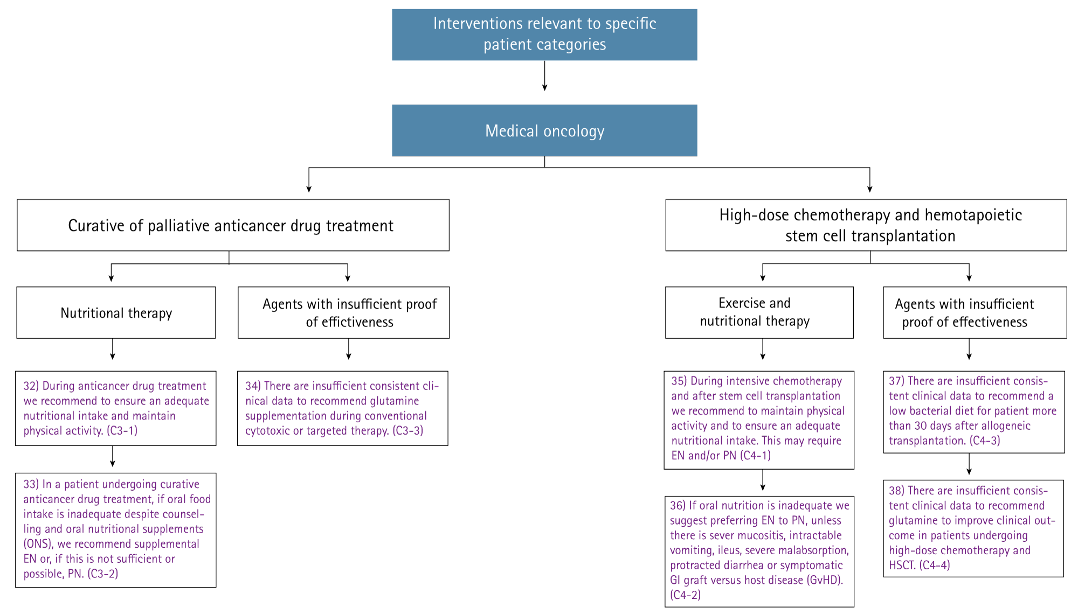
Interventions relevant to medical oncology patients.

Slide 38
Key points should be aiming for
1
EN & PN possible in patients undergoing curative anticancer drug treatment
2
EN & PN possible in High Dose Chemotherapy patients

Slide 39
THANK YOU
FOR YOUR TIME

